Slide 1
Going Dutch in Rio de Janeiro
What is the best place under the sun?

Slide 2
Introduction
For the Applied Data Capstone project “the battle of the neighbourhoods we will be looking at the best location to start a Dutch cuisine restaurant in Rio de Janeiro
Criteria: Other restaurants in the area and they should be highly rated on Zamato. Should have hotels in the neighbourhood.

Slide 3
Data used
We will be using the Zamato dataset on Kaggle to find the neighbourhood that has the best rated restaurants
We will use Foursquare location data to find what venues the neighbourhoods have

Slide 4
Methodology
We will use what we learned during the Apllied Data Science Course

Slide 5
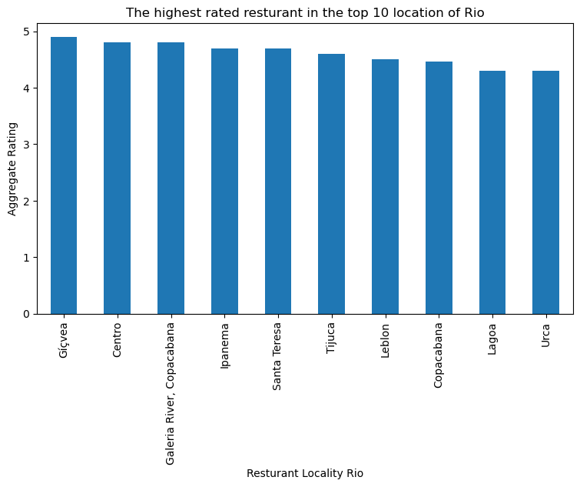
Zamato results

Slide 6
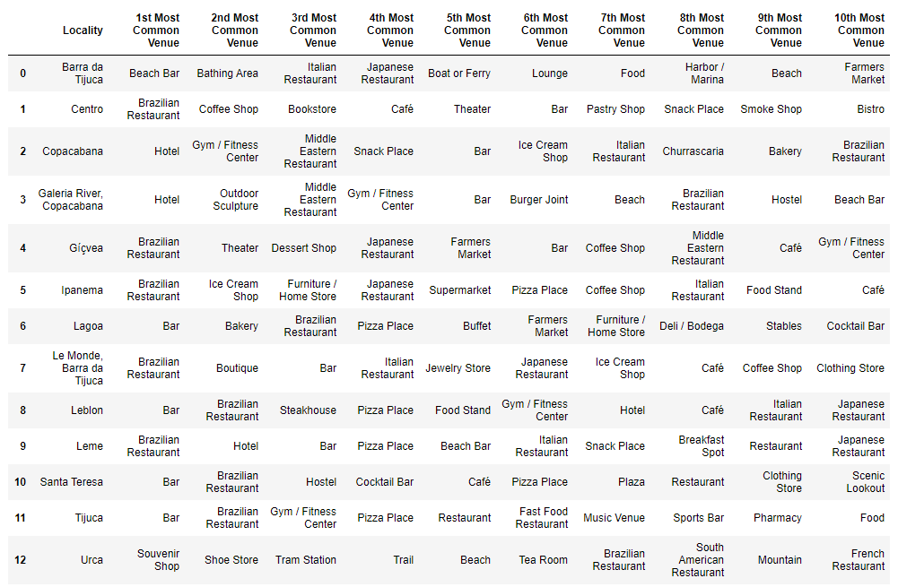
Foursquare results

Slide 7
Conclusion
Based on the data it has become clear that the best location to start a Dutch cuisine restaurant in Rion de Janeiro is Galeria River/Copacabana

